Slide 1
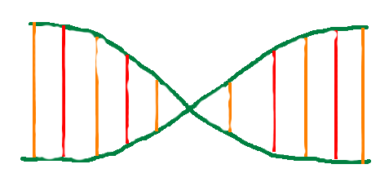
Darwin’s Nightmare
By Jonathan “Jake” Byman (jsb396), Michael Wagner (msw269)

Slide 2
Evolutionary Algorithms
Homework 1: “Evolution tends to perpetuate organism”
Used to model history of how organisms evolve

Slide 3
Evolution is randomness
Beginning of life, cellular organisms moved randomly
Can see a pattern
Used to predict the future, if done accurately
Over time got more intelligent, less random
What determines intelligence?
Foresight
Self-preservation

Slide 4
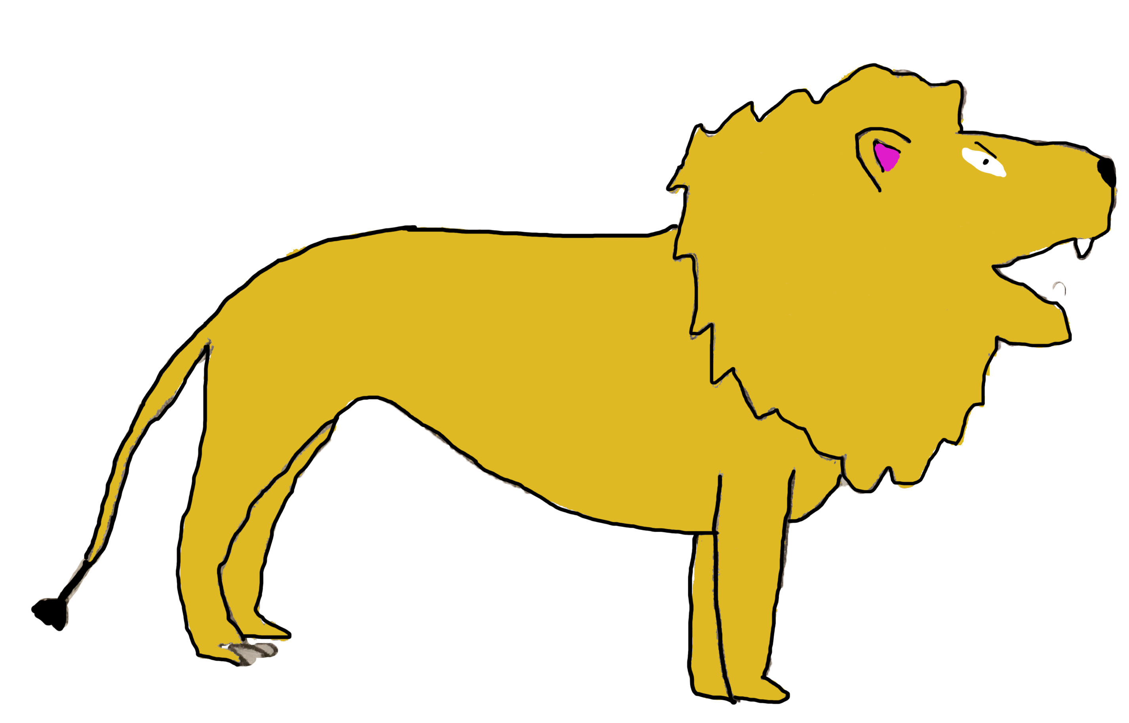
Proposal
To create a game that simulates the natural behavior of evolution
DNA is currency to evolve
Creatures become more intelligent over time
Using a QuadTree data structure
Swift: Mac OS

Slide 5
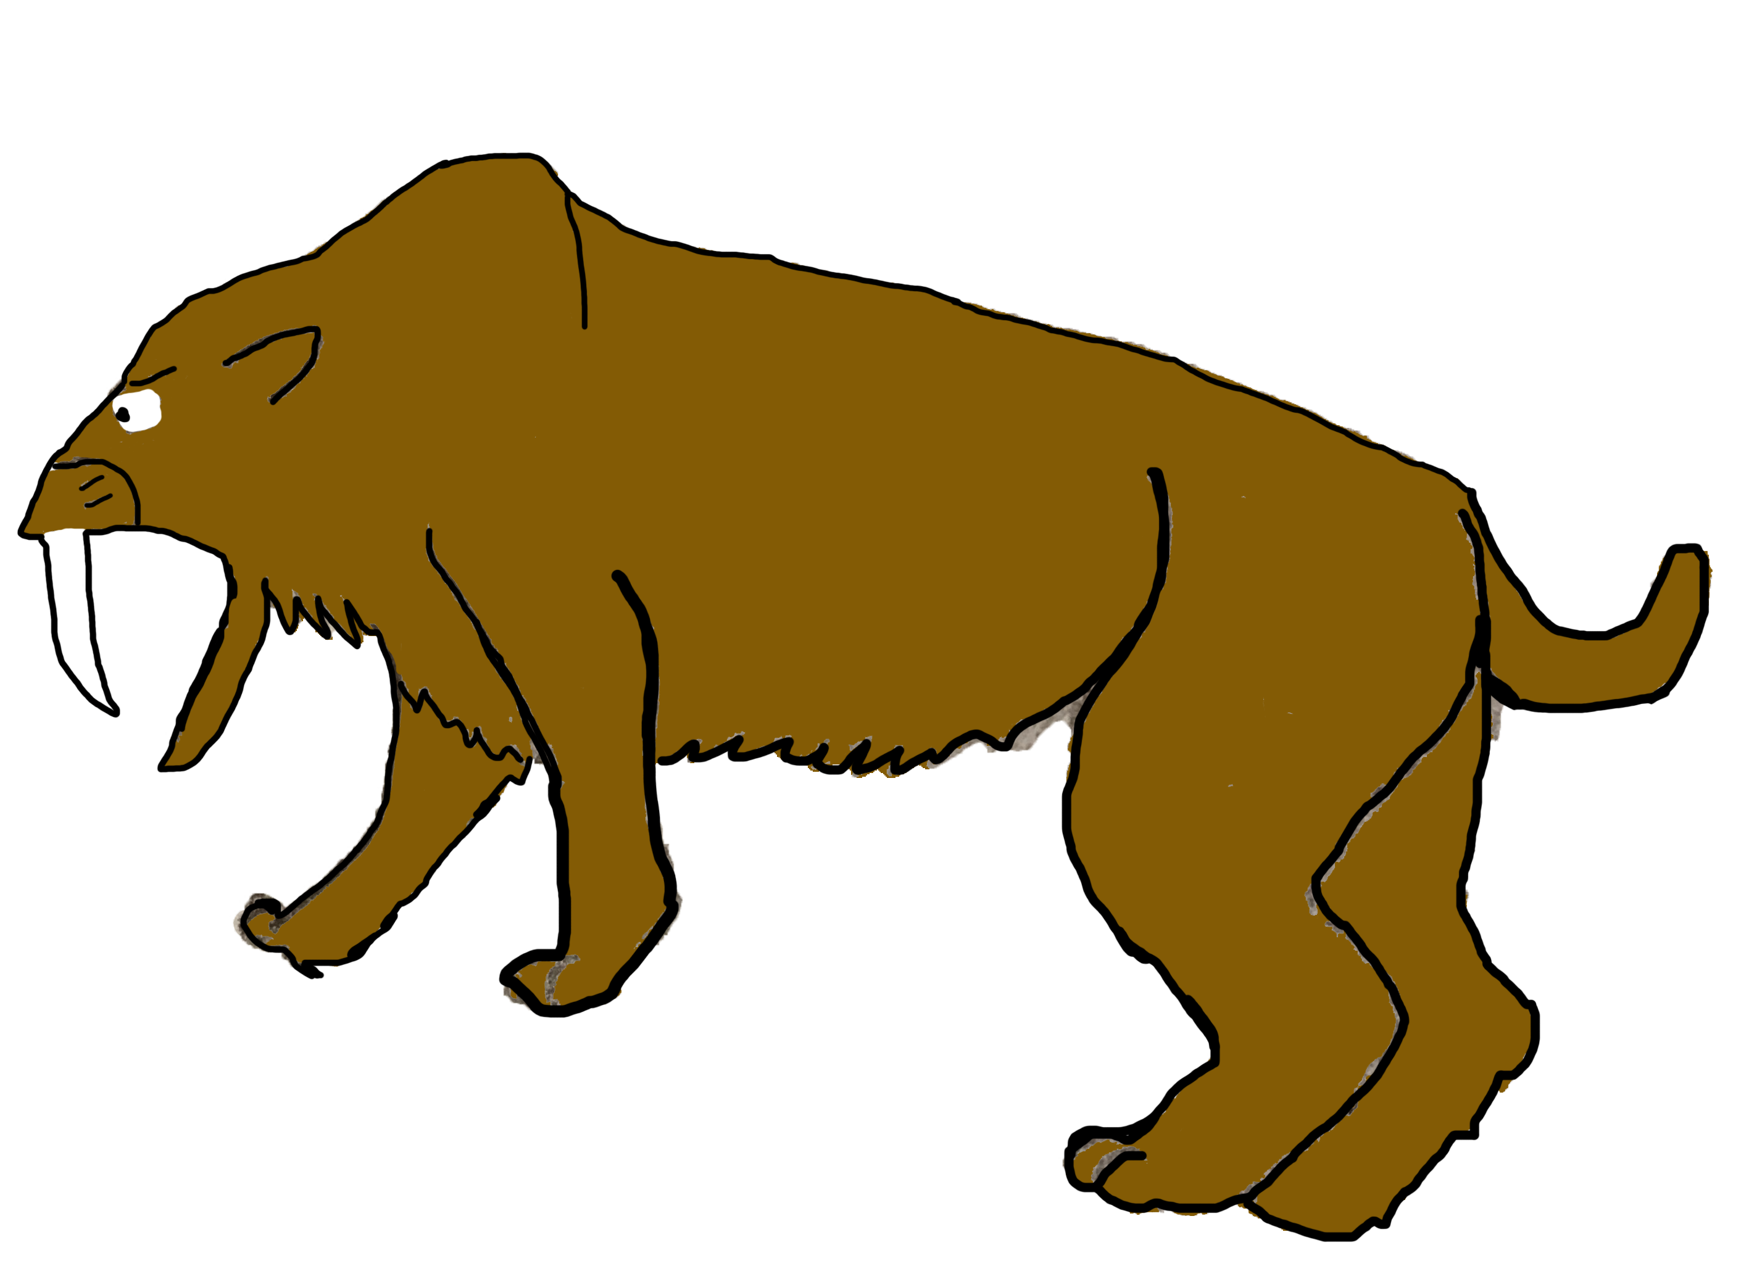
Product
Not quite a game
JavaFX
Emphasis on simulation
Using Graph data structure
Modified versions of BFS/DFS

Slide 6
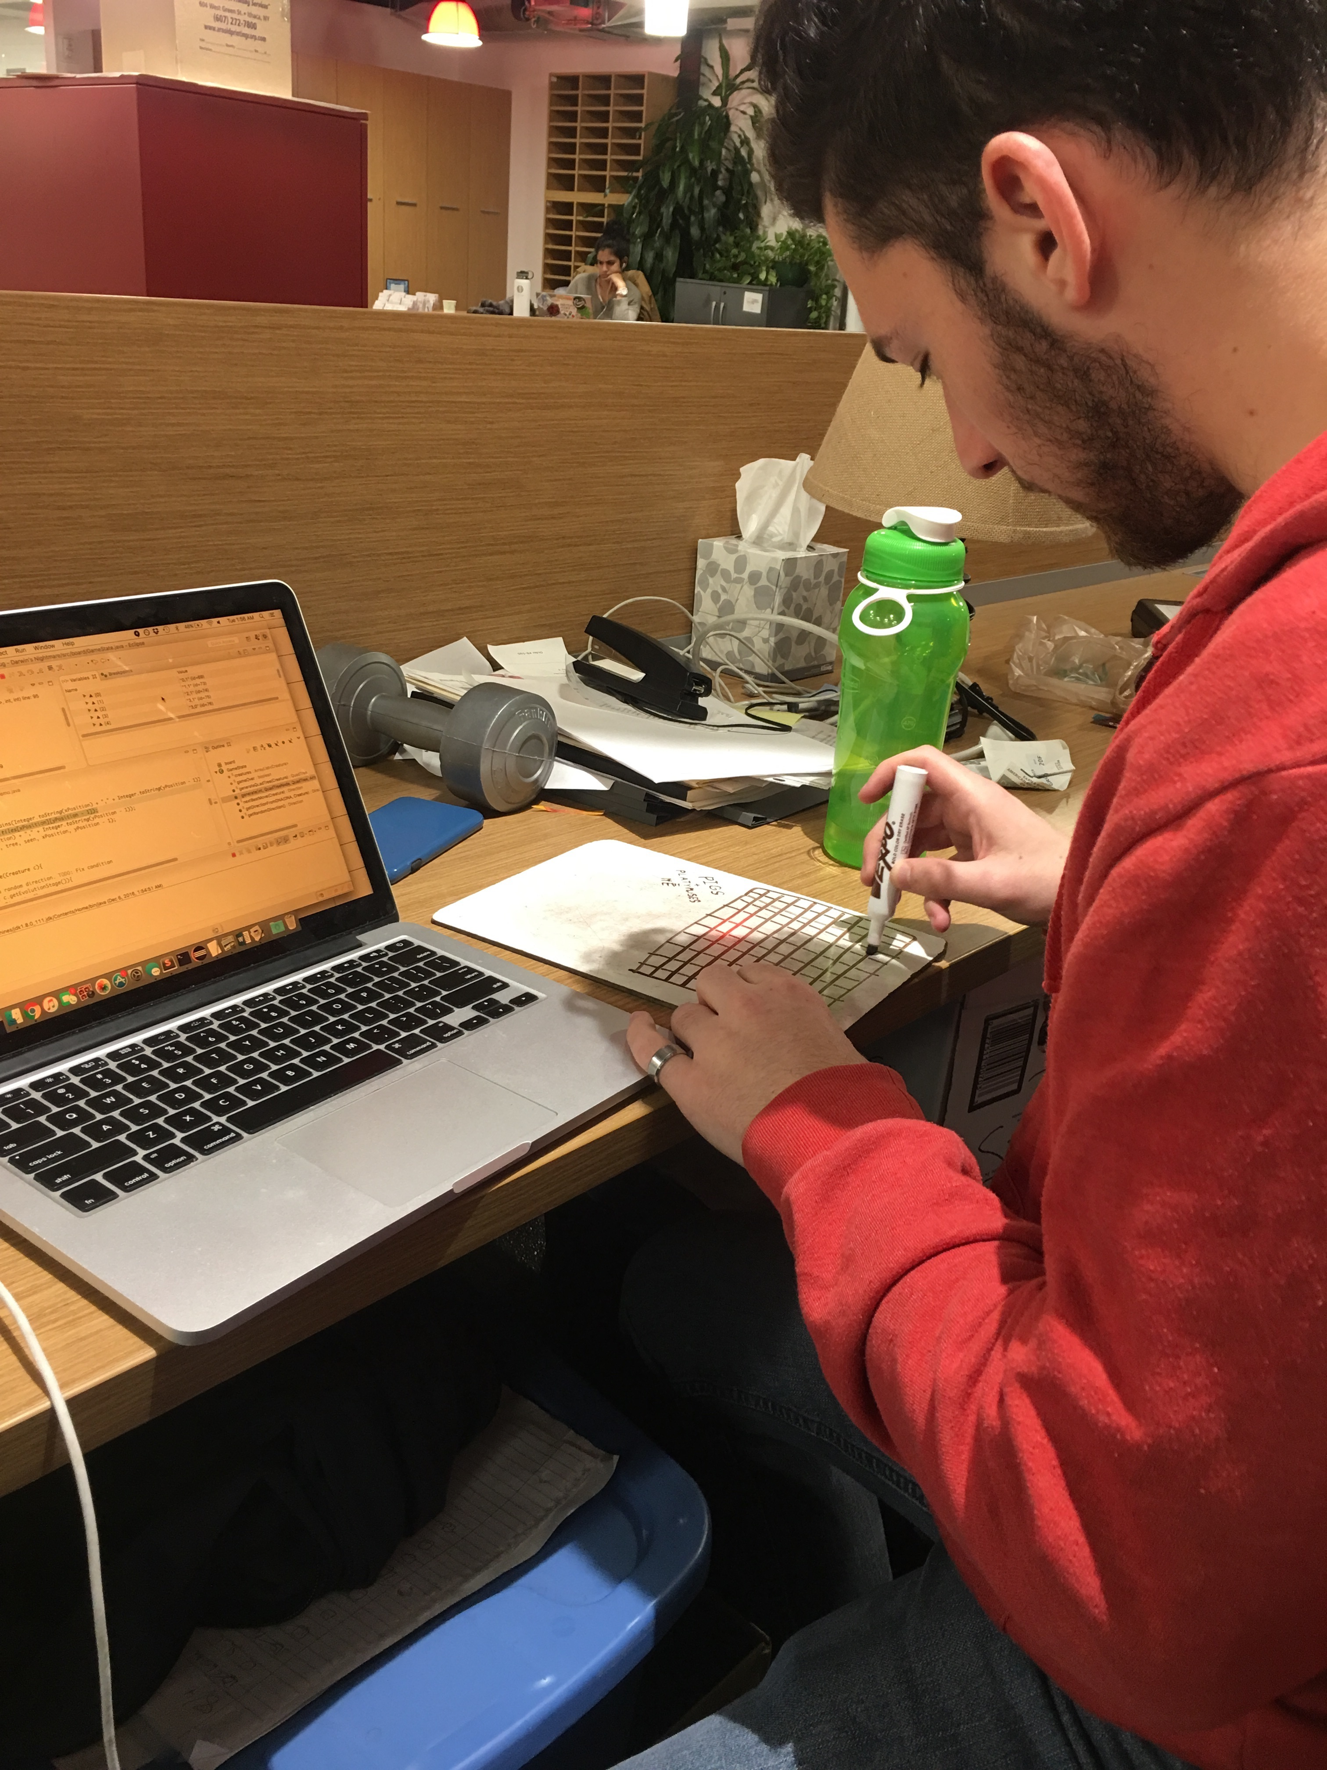
Development
Experience working together
Drawing on whiteboards
Hit milestones fairly well (+/- two days)

Slide 7
Code Structure
Written in Java with Eclipse
Separated into packages:
Application (Graphics)
Board
Create tile models
Control game state
Creature
Consumable Interface
Graph

Slide 8
Consumable Interface
DNA? Or Creature?
Java Interface
Way of representing either DNA or Creature
(x, y) and getDNA()

Slide 9
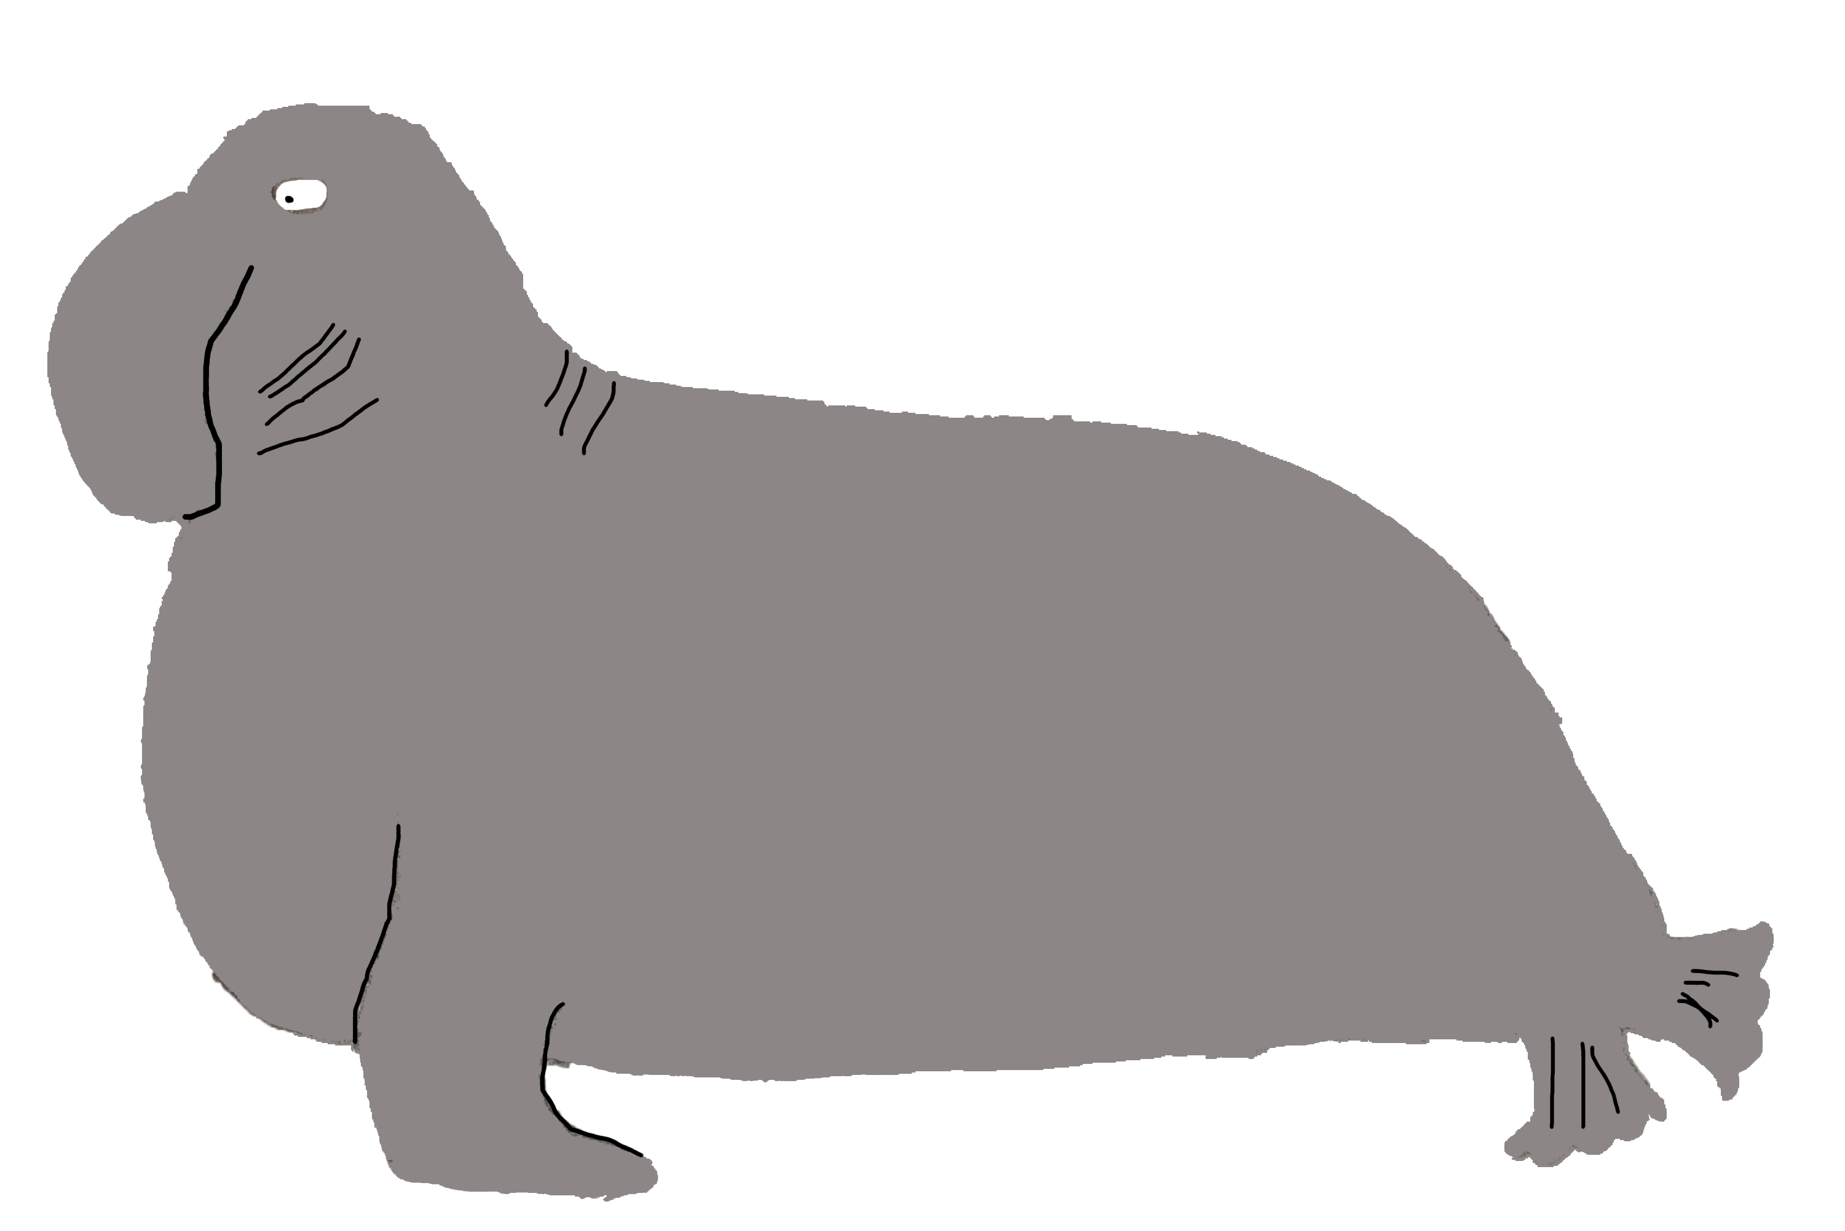
challenges
Creating QuadTree too memory intensive
Memory still tricky
Graph was much better
JavaFX a little tricky!
Measuring “intelligence”

Slide 10
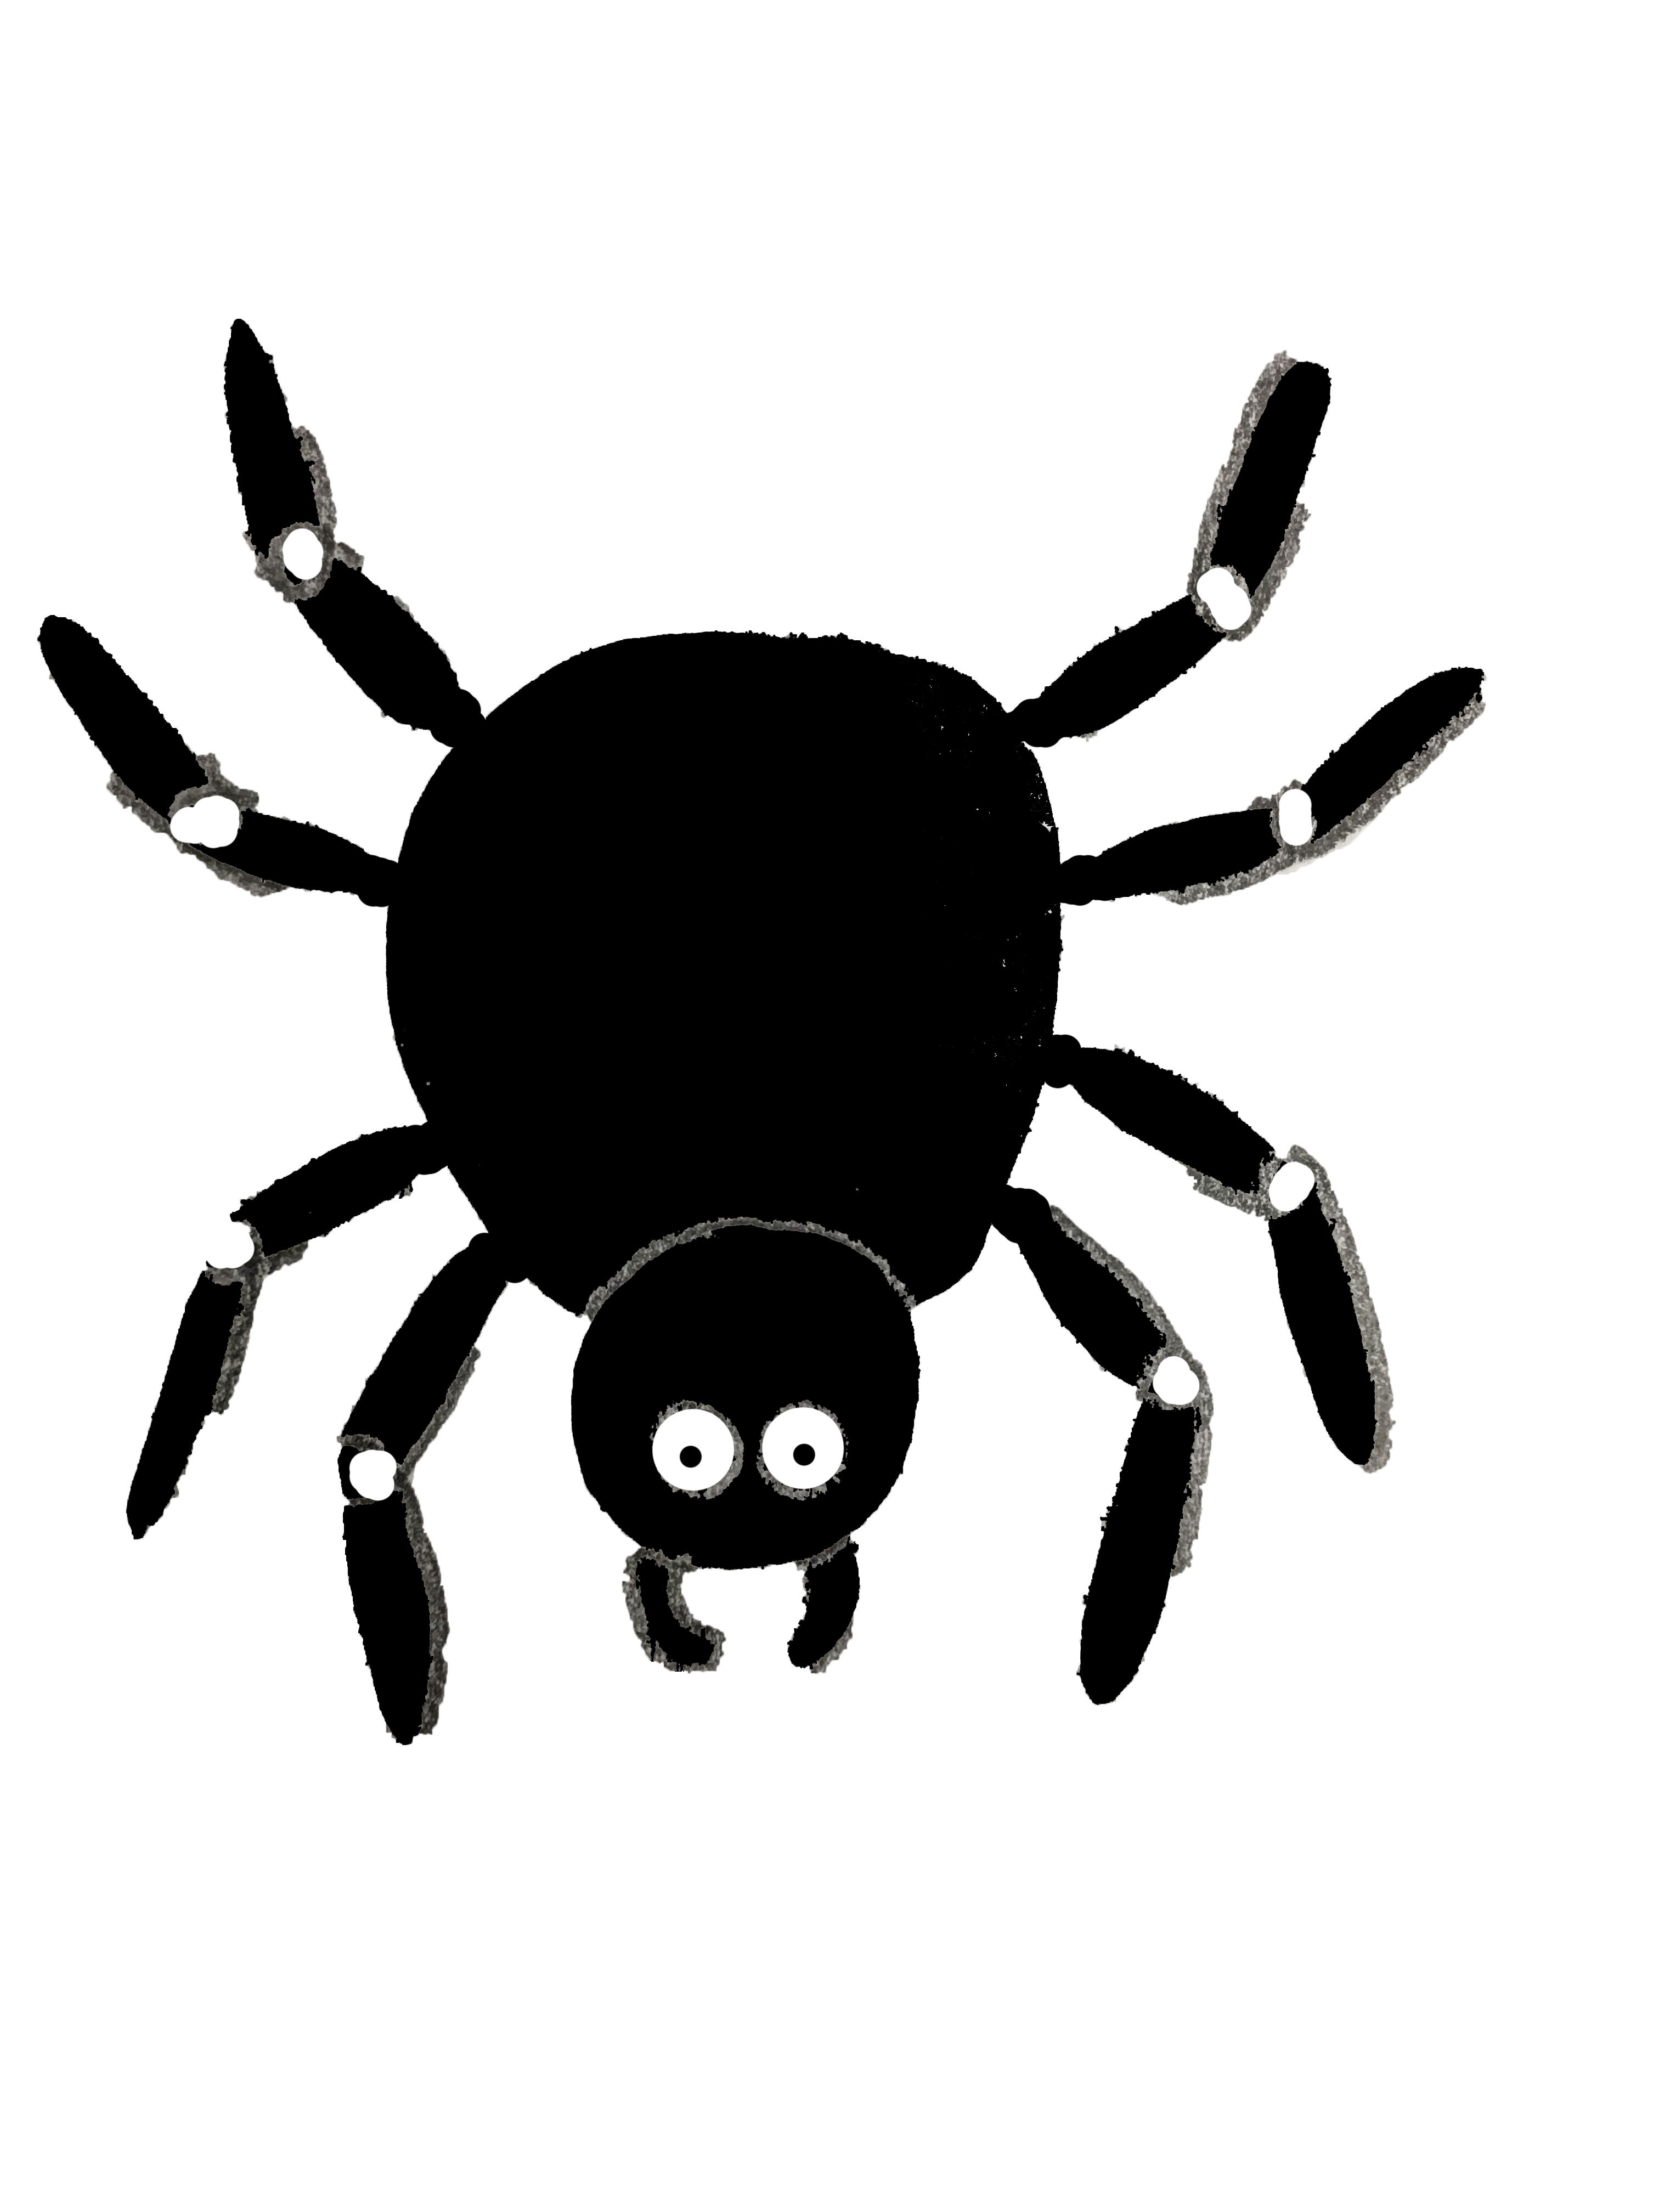
Lines of evolution
Not evolutionarily accurate! (Spider -> Spider monkey)
Denoted by a creature’s “level”
Threshold function determined when creature evolved: f(x) = 10 * (S + 1)^{2.5}
S denotes the evolutionary level

Slide 11
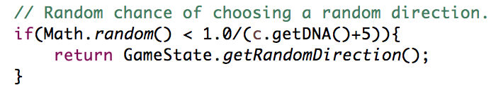
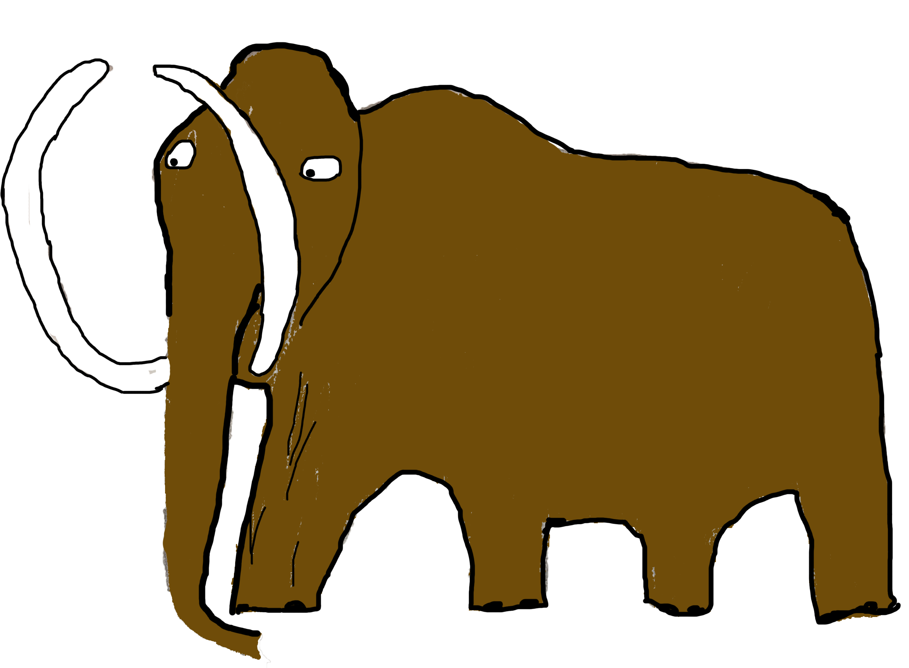
Metrics
How often does a creature become an “Apex Predator”?
Can creatures become too intelligent too quickly?
Randomness factor
BFS vs DFS?

Slide 12
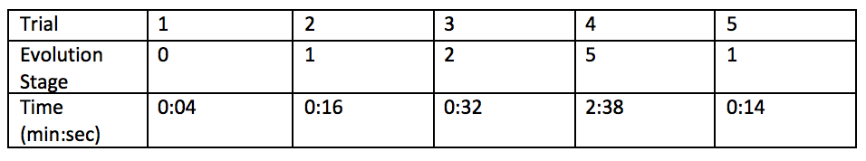

Results
With Breadth-First Search, and 20% chance of new creatures at each step, the original creature generally did not last very long
When the chance was lowered to 10%, the original creature faired much better

Slide 13
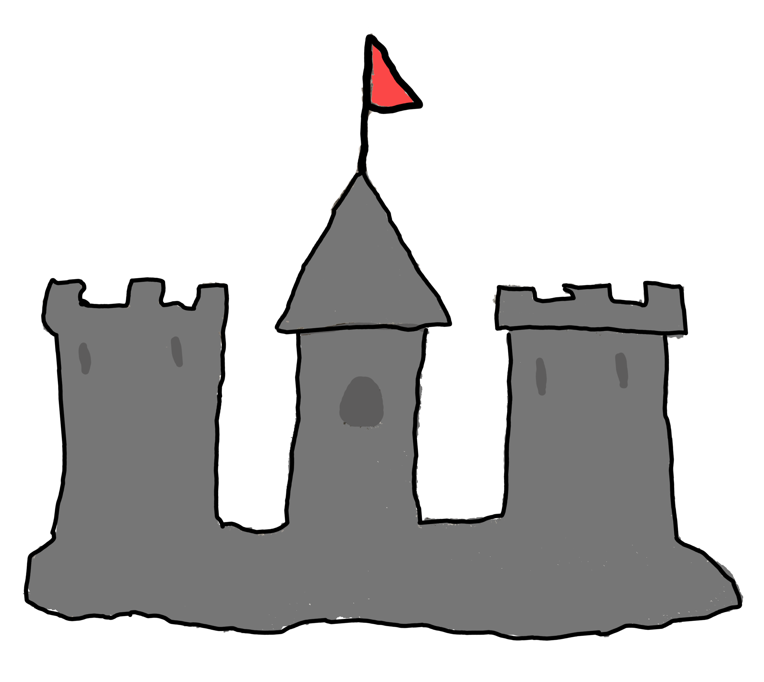
Future
More search algorithms
Foresight parameter?
Genetic algorithms
Procedurally generated sprite

Slide 14
Demo
Disclaimer: We are not graphic designers
Sound on!

Slide 15
Thank you!

